Slide 1
how to Pass Scrutineering
Taylor Davis, Interim Technical Director

Slide 2
Overview
What is Scrutineering?
Preparation
Execution
Breakdown of each Station
Additional Guidance

Slide 3
What is Scrutineering?
Inspection Process
Testing and Evaluation
Notes:
Thorough inspection process of both the car and the student’s ability to comprehend what their car consists of and how they built it. Over 160 initials needed

Slide 4
What is Scrutineering?

Slide 5
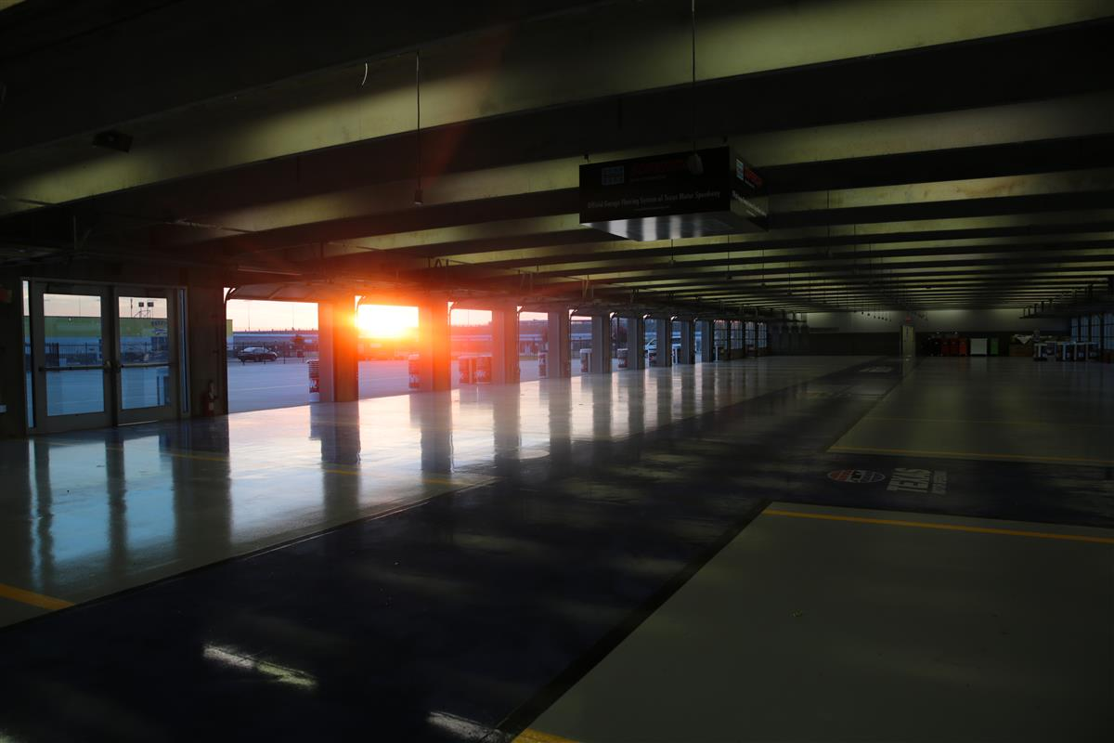
Preparation
Finish car before showing up
Collect, index all documentation
concerning car
If you think there is a problem, ask!
Notes:
Waivers – Teams wanting to use alternate dimensions must submit a waiver request to the Event Director before May 1. Waivers may not be requested at scrutineering. The waiver request must document what materials will be used and how these materials afford equivalent protection for the driver. A detailed mechanical drawing (in three views) must be included, showing the dimensions, material, and location of the roll cage members.

Slide 6
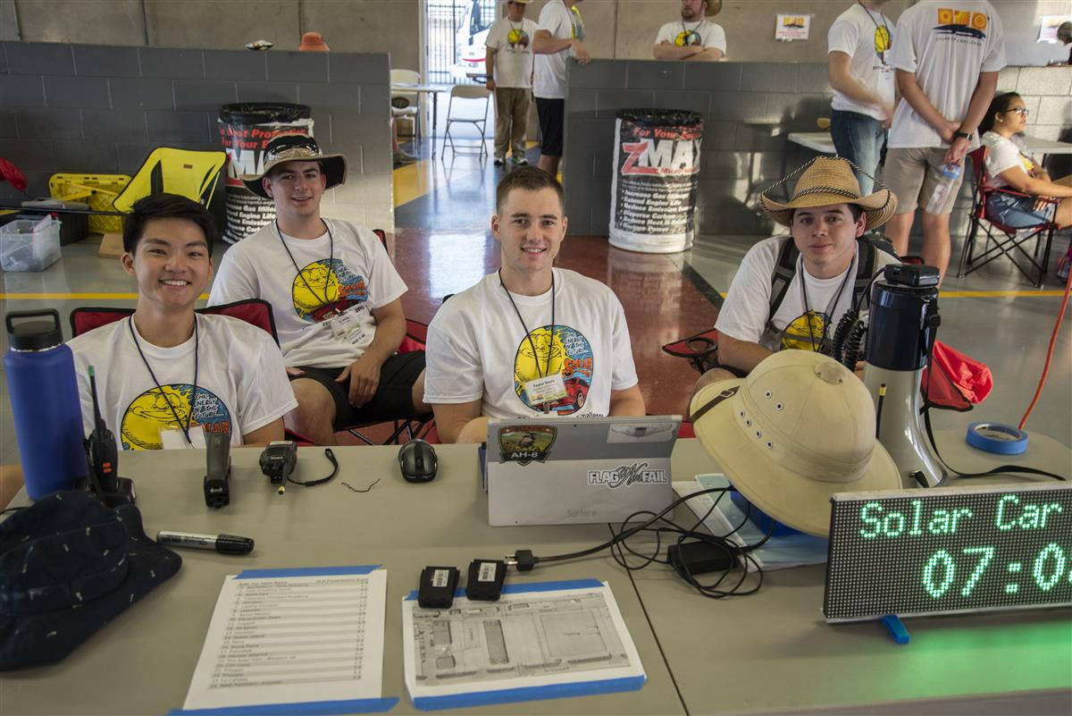
Execution
Be ready to go at the start of the first day
Visit every Station ASAP, even if you don’t
think you’ll pass!
Get as much feedback as possible from stations
before fixing problems

Slide 7
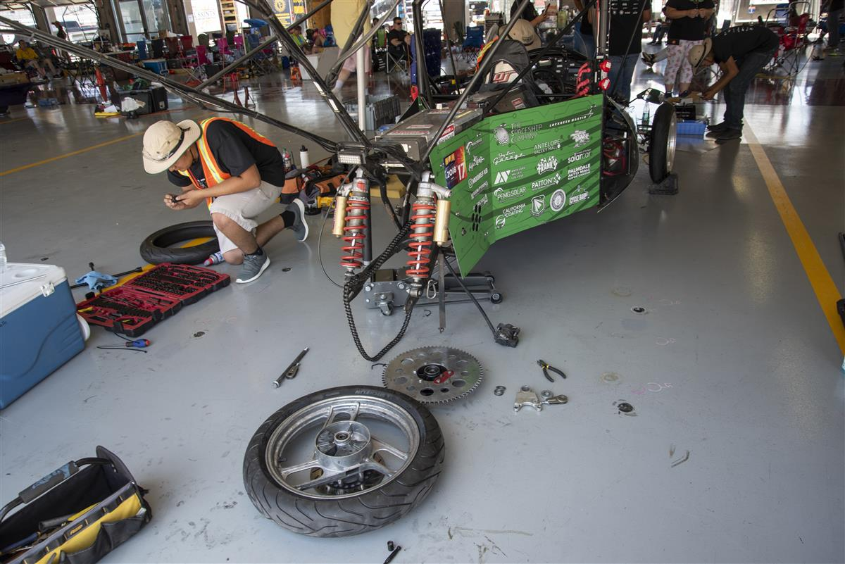
Execution
Teachers and Sponsors cannot be
present at the stations
Walk, don’t run

Slide 8
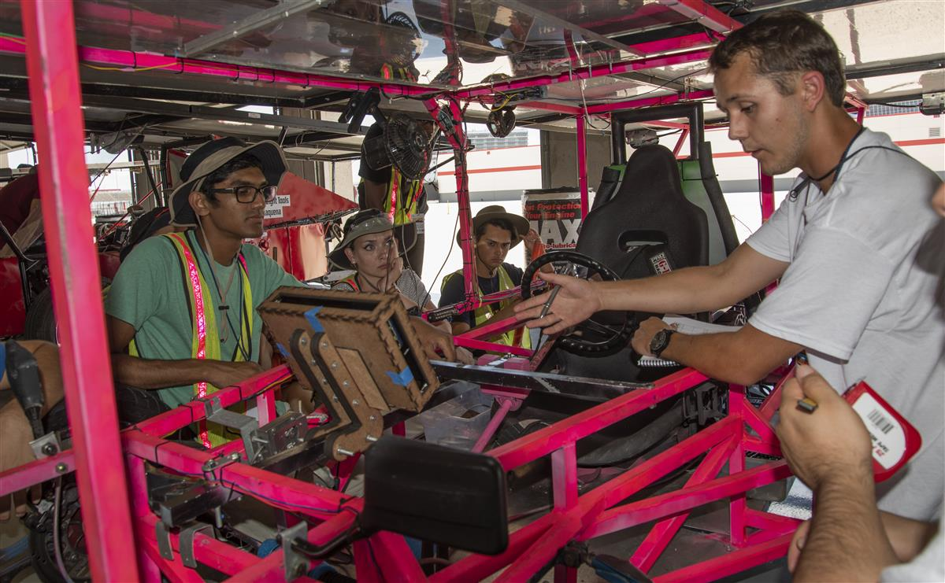
Station 1: Mechanical
Structural Inspections
Driver Visibility and Safety

Slide 9
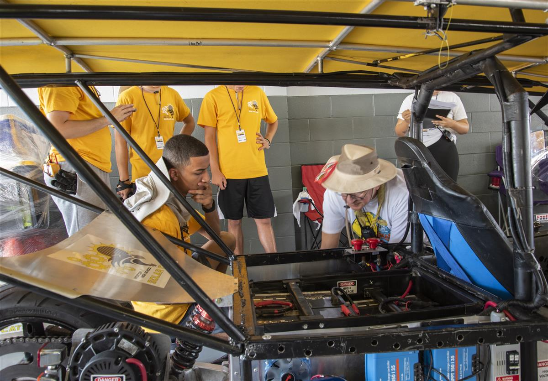
Station 2: Electrical
Electrical System Inspections
Understand your wiring diagrams
Understand your calculations
Fuse Rating
Battery Capacity
Do not ground to the frame of the vehicle

Slide 10
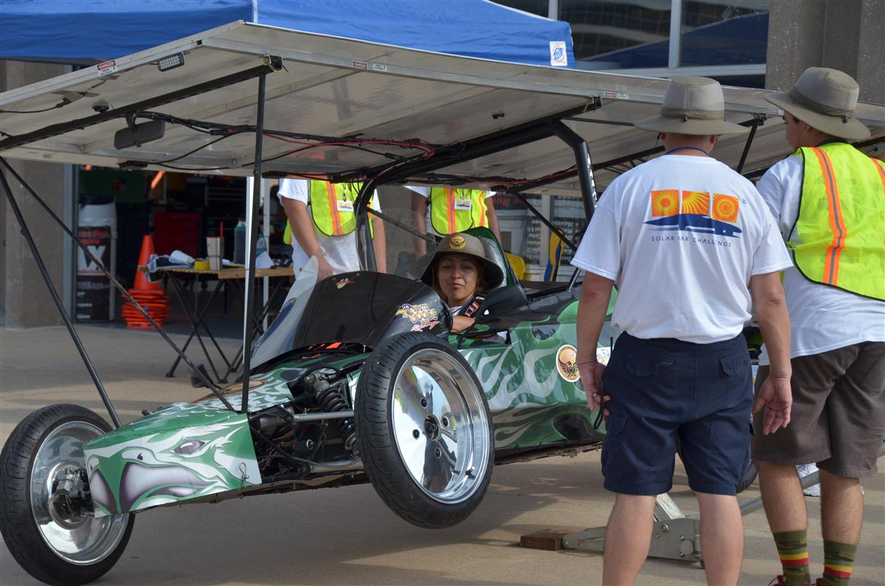
Station 3: Tilt and Turn
Suspension and Steering Inspections
180 Degree turn within 15m
Train on jacking the car up

Slide 11
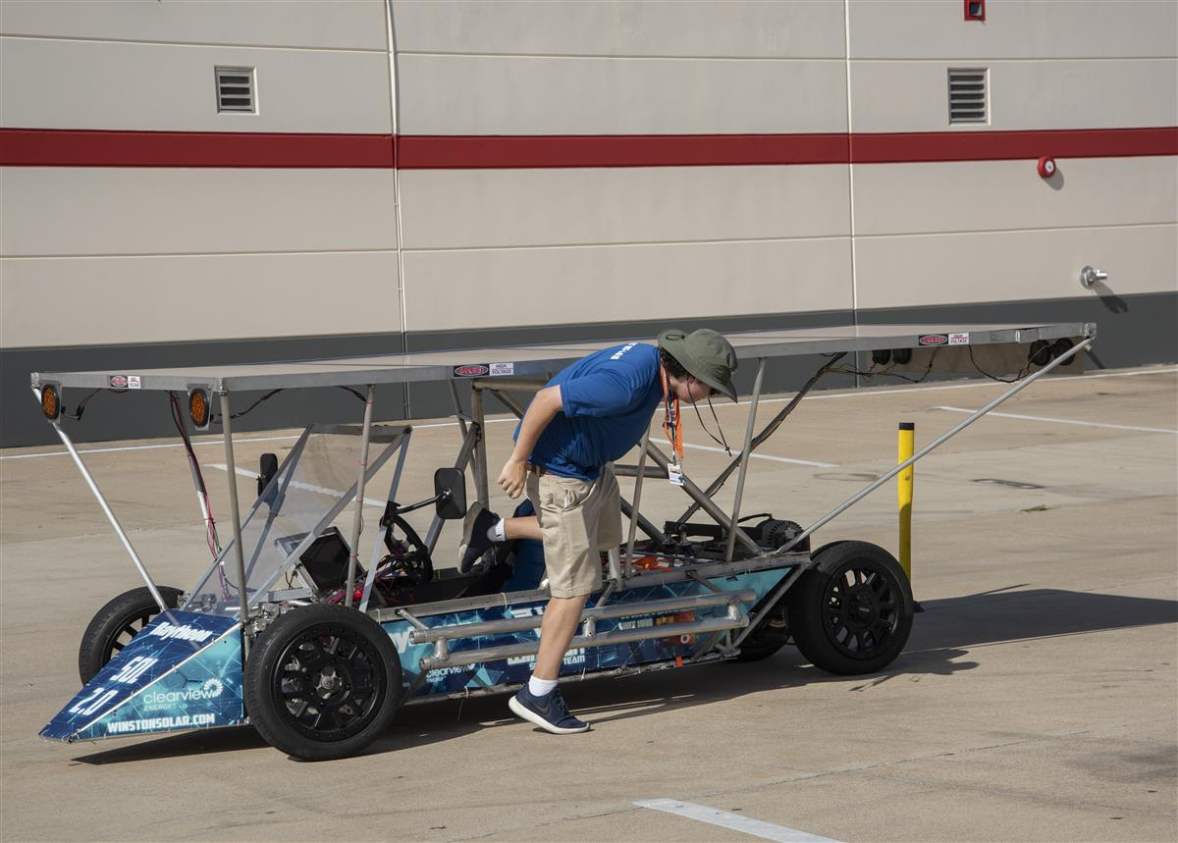
Station 4: Slalom
Dynamic Stability, Emergency Procedures
All drivers tested on course, 15 second egress
Discuss Emergency Procedures with team
Harness, Motor & Array Disconnects
Notes:
(Bring your licenses!)

Slide 12
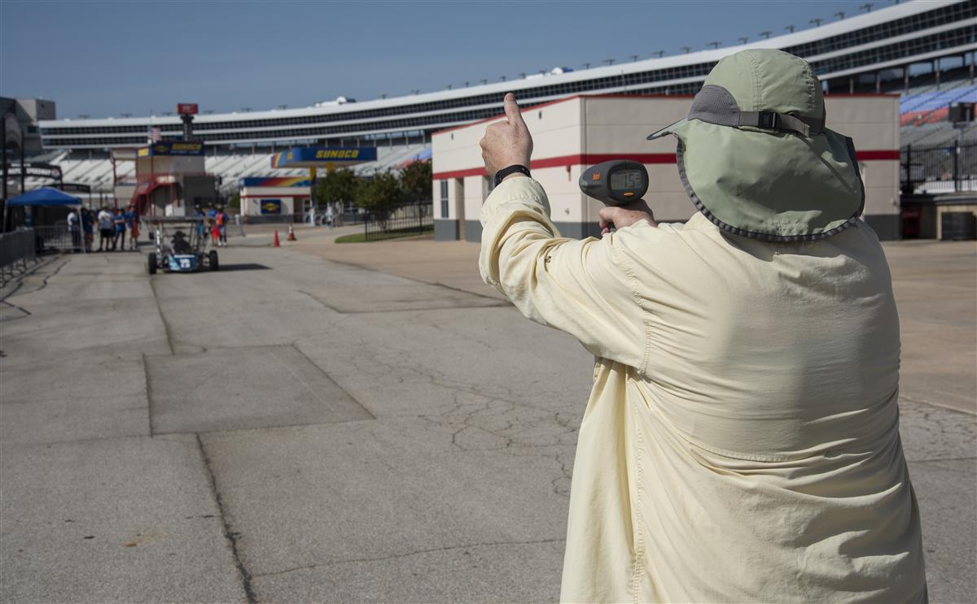
Station 5: Braking
Both component inspection and braking test

Slide 13
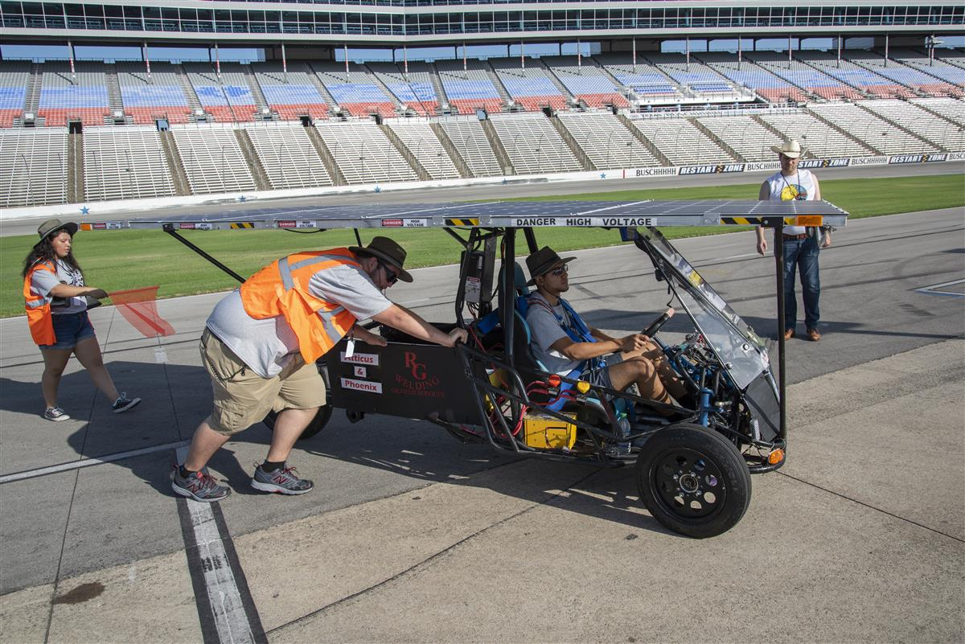
Station 6: Endurance Test
Track Operations
Qualifying Lap
Communications Test
Simulated Breakdown and Retrieval

Slide 14
Station 7: Cross Country
Cross Country Races only
Chase Vehicle Inspections/Convoy Procedures

Slide 15
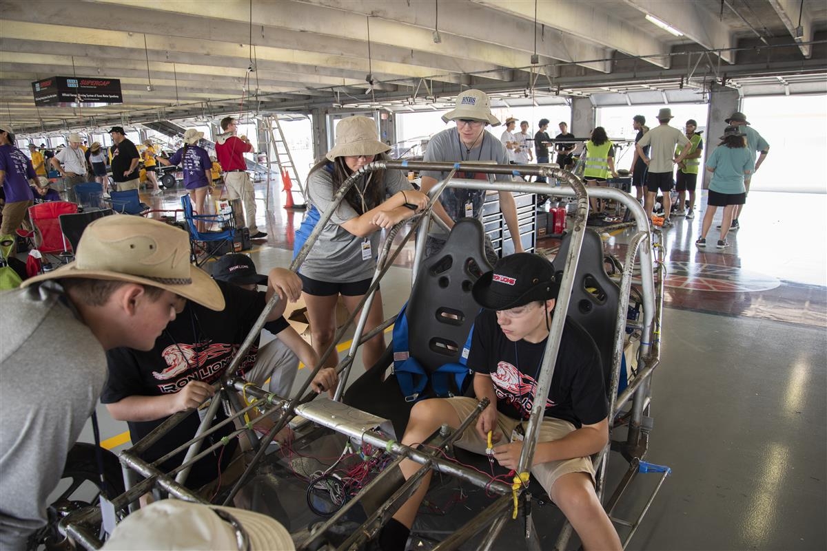
Station 8: Electric Solar Vehicle Station
ESV Division only
Battery Swap Procedures
Charging Station Inspection

Slide 16
Additional Guidance
Rules, Rules, RULES!
Scrutineering Documents
Veteran Teams

Slide 17
Questions?

